Slide 1
Scalabale Compute in Azure
Notes:
Suggested introduction:
Faced with _______
We did _______
And discovered_______

Slide 2
Compute on Azure
Rapid Development
App Service
Stream Analytics
Media Services
+++
Vertical Compute PaaS
General Compute PaaS
Azure Container Service
Azure Batch
Service Fabric
Cloud Foundry
VM Scale Sets
VM Extensions
IaaS and IaaS+
Virtual Machines
Full Control
Azure Public Cloud
Azure Stack
Notes:
The Azure platform offers a broad set of compute options. You can choose to have full control of your infrastructure where you are responsible for maintaining essentially all aspects of your environment (similar to an on-premises environment). Or, you can choose options that enable agile and rapid development environments, where the underlying infrastructure is managed for you.
In this session you will be exposed to most of the compute options available in the Azure platform.
<click>
Underneath any of the Azure services is the Azure Public Cloud or Azure Stack. This means that you can run the same workloads both in the public cloud as well as on-premises or in a third-party hosted cloud. Currently Azure Stack is still in preview, and as yet not capable of running all workloads currently available in Azure, but our goal is to reach feature parity as much as possible.
<click>
At the bottom of the ladder we have Virtual Machines. Every workload in Azure under the covers always runs on VMs, regardless of the type of service you get, and whether you can see the VMs.
Like your VMs on-premises, you can create individual VMs (aka instances), which you manage individually. If you need high availability, load balancing, and scaling, you need to configure this and apply it to the VMs this applies to.
<click>
VM Scale Sets are a set of VMs that you manage as a set. High availability, load balancing, and scaling are managed by the Azure platform. This is ideal for clustered environments that need to scale automatically.
<click>
VM Extensions are agents that you put inside a VM instance, or VMs part of a Scale Set. These agents allow you to manage the insides of the VM, such as performing configuration changes, updates, and backups.
<click>
VM Scale Sets are not just for you to use. Many Azure services run on VM Scale Sets as well, including Azure Container Service, Azure Batch, and Service Fabric.
Azure Container Service is a container platform running docker containers orchestrated by Apache Mesos or Docker Swarm.
Azure Batch enables you to run batch jobs on a schedule.
Service Fabric is a platform on which you can run Hyperscale micro-services based applications. Service Fabric is the same technology powering Microsoft’s cloud, provided to you to run your applications in the same scalable and robust manner.
<click>
Of course you don’t necessarily have to use scale sets to build scalable environments. You can also run third party tools such as Cloud Foundry on top of VMs.
<Click>
Beside General Compute PaaS, Azure contains many services performing higher level compute functionality, such as App Service to host modern cloud applications, Stream Analytics to analyze large streams of incoming data, and Media Services to process and stream media.
<click>
In this session we will focus on VM Scale Sets, Azure Container Service, and Service Fabric, so you understand their use case, and when to use which.

Slide 3
Virtual Machine Scale Sets

Slide 4
The Case for Cloud
Allocated IT-capacities
Load Forecast
“Under-supply“ of capacities
“Waste“ of capacities
Fixed cost of IT-capacities
IT CAPACITY
Barrier for
innovations
Actual Load
TIME
Notes:
You’ve probably all seen this image before. It depicts the inability of on-premises hardware to scale with your needs. This leads to overprovisioning in most cases, and can lead to under provisioning with severe business repercussions in some cases. If you run an e-commerce website handling thousands of transactions a day, running out of capacity will cause customers to go elsewhere to shop, potentially forever.

Slide 5
The Promise of Cloud
Load Forecast
Allocated IT capacities
No “under-supply“
IT CAPACITY
Reduction of “over-supply“
Possible reduction of IT-capacities in case of reduced load
Reduction of initial investments
Actual Load
TIME
Notes:
The promise of cloud is that you will never have a situation again where you are seriously over provisioned, or run out of capacity. But if you are mostly managing individual VMs, are you really tapping into this promise? You still have to manually add VMs when you run out of capacity, and you’ll have to tear those VMs down manually as well when you no longer need them. This is where Virtual Machine Scale Sets come in.

Slide 6
What are Virtual Machine Scale Sets?
Deploy and Manage multiple VMs as a set
A scalable compute platform
Integrated wth Azure Autoscale
Integrated with Azure Load Balancer
Ideal for clusters, farms, infrastructure for PaaS
Platform independent: Windows and Linux
Notes:
VM Scale Sets enable you to deploy and manage multiple VMs as a set. Instead of provisioning multiple individual VMs, you provision a Scale Set based on an image, just like a regular VM. The Azure platform then provisions and de-provisions VMs based on that image as needed. High availability, load balancing, and scaling are managed by the Azure platform by integrating with Azure Autoscale and the Azure Load Balancer. This makes VM Scale Sets ideal for server clusters or farms that need to scale automatically, such as a farm of web servers, rendering capacity for animations, etc.
Within Azure, and for third party providers, VM Scale Sets also serve as the infrastructure for PaaS. Azure Container Service and Service Fabric for instance use VM Scale Sets to automatically manage the number of VMs provisioned to run workloads. Workloads that have a variable load benefit greatly from VM Scale Sets, because the number of VMs provisioned always closely matches the number of VMs needed, delivering on the promise of cloud.
VM Scale Sets work with both Windows and Linux, so it will work with applications running on Apache in Linux, ASP.NET in IIS, and any other clustered workload running on these operating systems.

Slide 7
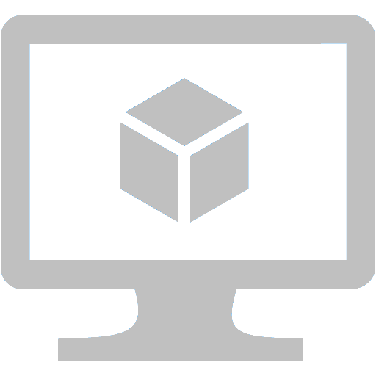
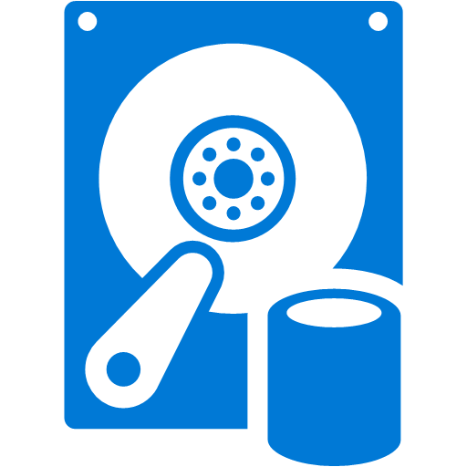
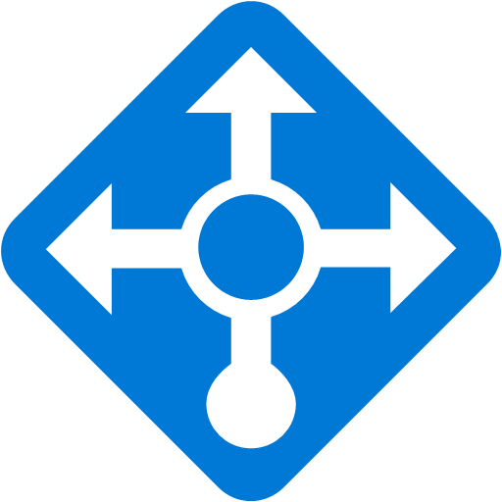
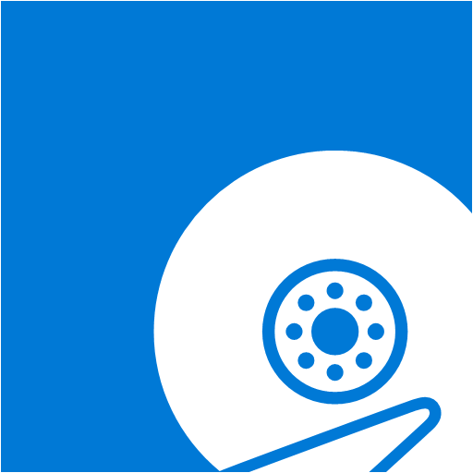
The Anatomy of a VM Scale Set
Scalable VM
Storage Accounts
Scalable VM
OS Disk
Agent
Extension 1
SA1
Extension 2
OS Disk
Agent
Extension 1
Scalable VM
Extension 2
Scalable VM
OS Disk
Agent
Extension 1
SA2
Extension 2
OS Disk
Agent
Extension 1
Scalable VM
Extension 2
OS Disk
SA3
Agent
Extension 1
Extension 2
Base OS Image
Notes:
A VM Scale Set builds on a few things: <click>
A Base OS image that serves as a base for every VM provisioned in the Scale Set.
One or more storage accounts.
A load balancer to divide the load over the provisioned VMs.
<click>
When a VM Scale Set is provisioned for the first time, you can set a minimum number of VMs that should be created. This can be just one VM, but just as with individual VMs, you should have more than one for high availability.
The VM is attached to a OS differencing disk based on the Base OS Image, and tied into the load balancer to ensure traffic flows to it. Like individual VMs, you can add VM Extensions to the VM. Because you are managing the VMs as a set, you typically don’t want to manage individual VMs, and with extensions for updating and configuration management, you can do just that.
<click>
As the load increases, additional VMs are created in the Scale Set, based on scaling rules you define when you create the Scale Set.
<click>
The number of VMs you can run with disks from a single storage account is limited, you should create multiple storage accounts, so differencing disks backing different VMs can be spread over them.
<click>
In a proper definition of a Scale Set, a single storage account holds multiple disks, placed in a round-robin fashion.
<click>
The disks baking VMs are removed when the Scale Set scales down when load decreases.

Slide 8

Resource Manager: Building a VM
Resource Group
virtualMachine
hardwareProfile
osProfile
storageProfile
networkProfile
Subnet
VM
networkInterface
privateIPAllocationMethod
publicIPAddress
allocationMethod
domainNameLabel
NIC
Public IP
Storage
storageAccount
accountType
virtualNetwork
addressSpace
Subnet
addressPrefix
VNET
Notes:
You build a VM Scale Set using an Azure Resource Manager template. Before getting into what that looks like, let’s look briefly at creating a single VM using ARM.
In your ARM template you have a Resource Group, in which you first define some of the base resources:
<click> You need a virtual network and subnet in which to place the VM.
<click> You need a storage account in which to store the disk of the VM.
<click> If you want the VM to be addressable from the outside world, you need a public IP address.
With the based resources in place, you can construct the VM itself.
<click>To tie the VM to the network and the public IP address, you need a NIC.
<click> And finally you can define the VM using the resources you’ve already defined.

Slide 9
Resource Loops: Multiple Resources
Resource Group
Subnet
Subnet
VM
VM
VM
…
NIC
NIC
NIC
VNET
Storage
Storage
Public IP
Public IP
Public IP
Notes:
If you want to deploy multiple VMs, let’s say several dozen or a hundred, there is something in Resource Manager that you can leverage called a Resource Loop. A resource loop in a like for-loop with an index number, and this enables you to create multiple resources of the same type using a base name combined with the index to form the full resource name. For each type of resource, VM, Public IP, Storage Account you have a separate resource loop, so you can create resources independently from one another.
Resource Loops are a good way to build multiple resources for large scale deployments.

Slide 10
Challenges of Scale
Need to correlate loops of independent resources, e.g. NICs, storage accounts, VMs
Different loop sizes for NICs and storage accounts etc.
No integrated mechanism to scale out
Scale in – How do you ensure availability?
Resource loops are a syntactical shorthand, but multiple calls go to fabric
Notes:
Considering we have ARM and resource loops, why do you need VM Scale Sets?
Using Resource Loops, there are several challenges to overcomes.
You need to correlate the loops of independent resources, because there is no 1-to-1 match between the resources of different types. For instance, you won’t likely create a separate subnet for each VM, and not all VMs may need a Public IP address. Also, if you would create one storage account per VM, you’d run into the limits of your subscription fairly quickly. (This will change in the future when we introduce the notion of Managed Storage, where Azure manageas your storage needs for a VM Scale Set).
Azure Autoscale does not integrate with ARM, so you would need to re-run the template with different numbers to scale up (or down).
When scaling in, how do you ensure that you are evenly deleting machines from Update Domains and Fault Domains, making sure that your application remains highly available?
In essence resource loops are syntactical shorthand. The same calls go to the fabric as if you have defined all VMs individually. They are definitely useful, and you can actually use them with VM Scale Sets, but VM Scale Sets take away much of the complexity that you have with resource loops, and ensure that when scaling availability is ensured.

Slide 11
VM Scale Sets in ARM
Manage groups of identical VMs
Auto-Scalable
Fast
Customizable
Windows or Linux
VM extensions
Open PaaS platform
Ease of Management
Focus on target instance count
Updateable
Resource Group
Scale Set
Subnet
VM
VM
VM
VM
…
Scalable NIC
Scalable Storage
NIC
Extensions
VNET
Notes:
VM Scale Sets integrate with Azure Autoscale. You define the rules under which auto-scaling needs to happen, and the VM Scale Set takes care of scaling.
When creating multiple VMs, Scale Sets are faster than using resource loops, because there is only one call going to the fabric, instead of a call for each VM to be created.
Because VM Scale Sets are based on VM instances, you can use pretty much anything you can use with VMs as well. This means that you can run Windows and Linux, and you can use VM Extensions. VM Extensions make it easier to manage the VMs in a Scale Set, for instance when deploying configuration changes, updating anti-virus, etc. Combining VM Scale Sets and VM Extensions help you to just focus on the instance count to most efficiently run your workload.
You can run updates with VM Extensions, or by logging on to individual VMs and making changes. Another way to update the Scale Set is by uploading a new image, so new VMs are created based on the new image. You then force update individual VMs currently active in the Scale Set.
<click>To create a VM Scale Set you need a Resource Group, and in it you create a VNET and subnet.
<click>You then define the VM Scale Set and say how many instance you want to start with, and the maximum number of instance you want to be able to scale up to.
<click>Instead of creating individual NICs, you define the network properties in your Scale Set definition.
<click>The same goes for your storage properties, and VM Extensions and anything else you may need.

Slide 12
VM Scale Sets vs. VMs
VMSS
VM
Deployment at scale
Autoscale
Pattern based name
Public IP per VMSS
Extension Params per VMSS
No Attached Data Disks
Deployment per VM
Scale fixed set of VMs
Permanent name/IP
Public IP per VM
Extensions Params per VM
Attached Data Disks
Notes:
The key difference between VMs and VM Scale Sets is deployment at scale. Although you can ultimately do that with VMs by provisioning many individual VMs, VMSS designed to deploy at scale. Autoscaling with VMs is possible, but you have to pre-provision all VMs, and then have Azure Autoscale turn VMs on and off. VMSS integrates with Autoscale, and creates and destroys VMs as needed.
Another important difference is parameters and naming. With a VMSS, naming of VMs is pattern based, as is the creation of the associated resources. The parameters for extensions are the same for each instance in a Scale Set, whereas with individual VMs these can be unique to the VM.
VMSS are mostly aimed at applications/platforms that scale well. You can’t attach data disks to a scale set to persist data. Persistent data needs to be stored another way.

Slide 13
VM Scale Set Limits
Current
100 VMs per Scale Set
5 Fault domains / 5 Update domains
40 VMs per storage account (custom images)
Default storage account limits
Future
>500 VMs/RG (future)
Reliability improvements - Overprovisioning (future)
Managed storage
Notes:
When working with VM Scale Sets you need to take into account the limits associated with them. Some of those limits will change as features are added to VMSS. The current limits tie into some of the limits that you have already when deploying individual VMs. If you work with custom images, you can only provision new VMs in the same storage account as the custom image. This is true for VMs, and as yet also for VMSS. As a result, you are limited to 40 VMs per storage account because of the bandwidth limitations of a storage account. This will change in the future when we introduce managed storage. For very large deployments we will also support more than 500 VMs per Resource Group, using multiple Scale Sets.
We are also looking at overprovisioning to increase the reliability. If you provision 100 VMs in a Scale Set, we may actually provision 105, so that if a few VMs fail to deploy, you still get a 100 VMs. Any VMs we overprovision will at some point be discarded. You will not have to pay for overprovisioning.

Slide 14
Persisting Data with a VM Scale Set
Data is stored.. | Pros | Cons
OS Drive | Self-contained, backed by data service | Poor design in many scenarios. Storage limited.
Temp drive | Local, ephemeral, good for stateless scenarios. | Not backed by storage RP. Storage limited.
Azure Files | Storage can be shared across clients. Perf/scale work ongoing. | Limited scale and performance.
Azure Blobs | Data is a reliable service backed by storage. | Existing apps need redesign. IOPS limits
Azure Tables | Data is a reliable service backed by storage. | Simple data structure. App redesign.
Remote source (e.g. DB) | Data is a service separate from app infrastructure. | Only suitable for a subset of apps.
3rd party shared storage e.g. Lustre | Storage shared across clients. Scalable performance. | Lustre is Linux only.
Notes:
Storing data on the OS Drive or Temp Drive suffers from the same disadvantages as a VM. In addition to that, data stored on the OS Drive may be lost when a Scale Set scales down and the differencing disk is destroyed. Unless your application is stateless, you need to use some other form of data storage. For new applications Azure Blobs and Tables are excellent was to store data, but you can also use a remote source such as Azure SQL Database. For older applications requiring shared storage, Azure Files may be a solution, although there are currently limitations with regards to scale, performance, and fine grained security (this will change in the future).
With third party shared storage tools such as Lustre, you can leverage the OS disk and/or temp drive to create shared storage across VMs in a scale set.
use a 3rd party storage solution such as Lustre

Slide 15
Managing VM Scale Sets
Infrastructure
Azure Resource Manager
Azure CLI
PowerShell
VM Internals
PowerShell DSC
Chef, Puppet etc.
Notes:
Managing VM Scale Sets is possible through ARM, Azure CLI, and PowerShell. You can initially deploy a Scale Set with ARM, and then modify the Scale Set by modifying the template, and then reapply the template.
To update the internals of the VMs, for instance anti-virus updates, OS updates, and minor configuration changes, using VM extensions with PowerShell DSC, Chef, Puppet or other configuration management tools works best. For major changes you should update the base image, which will ensure that new instances are created based on that image. We are working on a feature to also update running VMs with the latest base image. Currently you need to kill the existing VMs to force an update.

Slide 16
Virtual Machine Scale Sets

Slide 17
Micro-services Architecture
Notes:
Sources:
Microservices: An application revolution powered by the cloud, M. Russinovitch - https://azure.microsoft.com/nl-nl/blog/microservices-an-application-revolution-powered-by-the-cloud/

Slide 18
Application Challenges
High Availability
Scalability
Agile
Continuous Innovation/Evolution
Notes:
We are in the midst of an application development and IT system management revolution driven by the cloud. Fast, agile, inexpensive, and massively scalable infrastructure, offered fully self-service and with pay-as-you-go billing, is improving operational efficiency and enabling faster-time-to-value across industries. The emergence of containers, with their fast startup, standardized application packaging, and isolation model, is further contributing to efficiency and agility.
However, many companies are finding that making their applications highly available, scalable and agile is still challenging. Competitive business pressures demand that applications continuously evolve, adding new features and functionality while remaining available 24x7. For example, it is no longer acceptable for a bank website to have a maintenance window, whereas even a few years ago it was the norm. Similarly, an e-commerce site that’s down for even a short time will drive customers to one of many competitors that can serve them at that moment. Failure to meet these demands can mean the difference between staying relevant and losing business.
These business realities are driving developers to adopt an application architecture model called “microservices,” a term popularized by James Lewis and Martin Fowler. I’ll talk about how and why a microservices architecture can help with application development and lifecycle tasks, and describe the capabilities that platforms can provide to support those architectures. Then I’ll list some of the platforms commonly used by developers as the foundation for their microservice based applications that Azure supports, and finally, I’ll describe our microservice application platform, called Service Fabric, that provides comprehensive support for microservices lifecycle management out of the box.

Slide 19
3-Tier Monolithic Application
Web
Business Logic
Data
Notes:
For decades, the cost, time, and complexity of provisioning new hardware, whether physical or virtual, has strongly influenced application development. These factors are more pronounced when those applications are mission-critical, since high uptime requires highly available infrastructure, including expensive hardware such as SANs and hardware load-balancers. Because IT infrastructure is static, applications were written to be statically sized and designed for specific hardware, even when virtualized. Even when applications were decomposed to minimize overall hardware requirements and offer some level of agility and independent scaling, it was commonly into the classic three-tier model, with web, business logic and data tiers, as shown in the figure below. However, each tier was still its own monolith, implementing diverse functions that were combined into a single package deployed onto hardware pre-scaled for peak loads. When load caused an application to outgrow its hardware, the answer was typically to “scale up,” or upgrade the application’s hardware to add capacity, in order to avoid datacenter reconfiguration and software re-architecture.
The monolithic application model was a natural result of the limitations of infrastructure agility, but it resulted in inefficiencies. Because static infrastructure and long development cycles meant that there was little advantage to decomposing applications beyond a few tiers, developers created tight coupling between unrelated application services within tiers. A change to any application service, even small ones, required its entire tier to be retested and redeployed. A simple update could have unforeseen effects on the rest of the tier, making changes risky and lengthening development cycles to allow for more rigorous testing. Their dependence on statically-assigned resources and highly-available hardware made applications susceptible to variations in load and hardware performance, which could push them outside their standard operating zone and cause their performance to severely degrade. An outright hardware failure could send the entire application into a tailspin.

Slide 20
3-Tier Monolithic Application (Improved)
Load Balancer
Web
Web
Cache
Business Logic
Cache
Data
Notes:
Finally, another challenge facing monolithic applications that took advantage of a tiered approach was delivering fast performance with data stored in the backend tier. A typical approach was to introduce intermediate caches to buffer against the inefficiencies caused by separating compute and data, but that raised costs by adding unused hardware resources, and it created additional development and update complexities.

Slide 21
Micro-services Architecture
Web
HTTP Listener
Page Content
Authentication
Business Logic
Product Management
Order Management
Analytics
Data
Product Inventory
Customer Data
Notes:
While there are simple and limited scale applications for which a monolithic architecture still makes sense, microservices are a different approach to application development and deployment, one that is perfectly suited to the agility, scale and reliability requirements of many modern cloud applications. A microservices application is decomposed into independent components called “microservices,” that work in concert to deliver the application’s overall functionality. The term “microservice” emphasizes the fact that applications should be composed of services small enough to truly reflect independent concerns such that each microservice implements a single function. Moreover, each has well-defined contracts (API contracts) – typically RESTful - for other microservices to communicate and share data with it. Microservices must also be able to version and update independently of each other. This loose coupling is what supports the rapid and reliable evolution of an application.

Slide 22
Hosting Micro-services
Microservices
Application 1
VM1
VM3
VM5
Cluster Manager
Microservices
Application 2
VM2
VM4
VM6
Notes:
Microservice-based applications also enable the separation of the application from the underlying infrastructure on which it runs. Unlike monolithic applications where developers declare resource requirements to IT, microservices declare their resource requirements to a distributed software system known as a “cluster manager,” that “schedules,” or places, them onto machines assigned to the cluster in order to maximize the cluster’s overall resource utilization while honoring each microservice’s requirements for high availability and data replication. Because microservices are commonly packaged as containers and many usually fit within a single server or virtual machine, their deployment is fast and they can be densely packed to minimize the cluster’s scale requirements.
There are several benefits that this enables:
<click> A microservice that fails is automatically recreated, potentially on a different server.
<click> Adding capacity is easy, as you only need to add servers with the same configuration.
<click> If a microservice needs more capacity, it can be scaled by creating a bigger instance, potentially on a different server, and then destroying the old instance.
<click> If a server fails, all microservice are moved to other servers.
<click> You can host multiple applications on a cluster.
<click> The cluster determines where microservice are place, and can provision additional instances as needed.

Slide 23
Micro-service Advantages
Nearly instantaneous scale-out
Microservices scale independently
Rolling updates
Stateful Microservices avoid network overhead
Integration with CI and CD pipelines
Notes:
With this model, microservice scale-out can be nearly instantaneous, allowing an application to adapt to changing loads. Their loose coupling also means that microservices can scale independently. For example, the public endpoint HTTP listener, one microservice in the Web-facing functionality of an application, might be the only microservice of an application that scales out to handle some additional incoming traffic.
The independent, distributed nature of microservice-based applications also enables rolling updates, where only a subset of the instances of a single microservice will update at any given time. If a problem is detected, a buggy update can be “rolled back,” or undone, before all instances update with the faulty code or configuration. If the update system is automated, integration with Continuous Integration (CI) and Continuous Delivery (CD) pipelines allow developers to safely and frequently evolve the application without fear of impacting availability.
While the classic model for application scalability is to have a load-balanced, stateless tier with a shared external datastore or database to store persistent state, stateful microservices can achieve higher performance, lower latency, massive scale and maintain developer agility for service updates. Stateful microservices manage persistent data, usually storing it locally on the servers on which they are placed to avoid the overhead of network access and complexity of cross-service operations. This enables the fastest possible processing and can eliminate the need for caches. Further, in order to manage data sizes and transfer throughputs beyond that which a single server can support, scalable stateful microservices partition data among their instances and implement schema versioning so that clients see a consistent version even during updates, regardless of which microservice instance they communicate with.

Slide 24
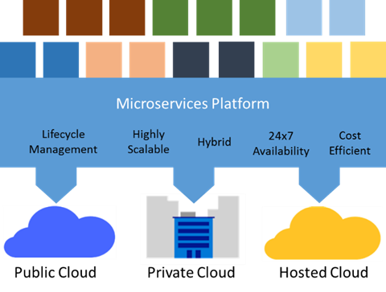
Micro-services Platform
Notes:
TODO: Improve image
Our experience internally running cloud-scale Microsoft services like Bing, Cortana and Intune have given us a deep firsthand understanding of the complexities associated with designing, developing, and deploying large-scale applications at cloud scale. Frequent updates to large-scale, always on applications is a challenge, no matter how well designed the application. Just dropping microservices into virtual machines or even containers does not enable the full potential of the microservices approach, that requires a microservices application platform with DevOps-focused tooling.
A full-featured microservices application platform provides all the previously stated microservices architecture benefits of cost efficiency, scalability and 24x7 availability. It also takes these a step further. As mentioned earlier, it should choreograph safe and reliable upgrades using an extensible health model and automatic rollback. It also helps microservices to discover each other by providing a naming service, and monitors and maintains their health. For example, when scaling or healing, a microservices platform communicates updated placement information to other microservices via the naming service so that they can quickly establish or re-establish communication.
To keep microservices healthy, the platform automatically moves instances to healthy VMs or servers when the software or hardware on which they are running fails or must be restarted for upgrades. In addition, a microservices platform must be deployable in private and public clouds. This is necessary to support hybrid scenarios where workloads burst from a private cloud to a public one, and to enable public cloud dev/test with production deployment in a private cloud. Supporting multiple clouds also addresses concerns about vendor lock-in when choosing an application platform, separating the platform from the infrastructure.

Slide 25
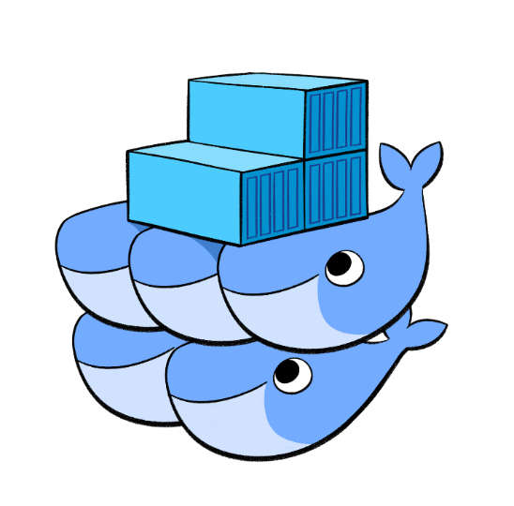

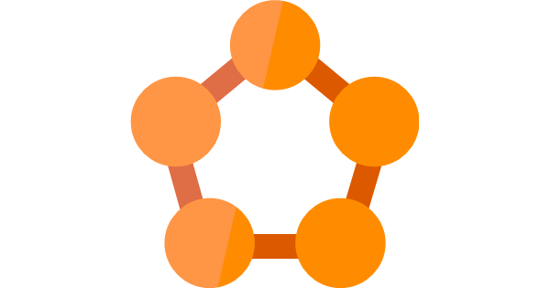
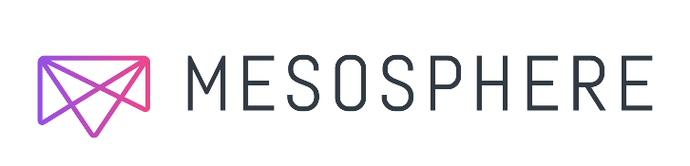
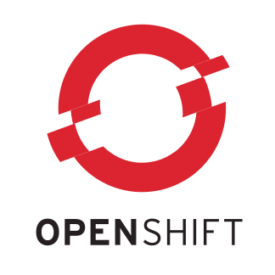
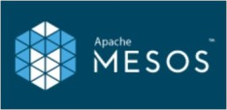
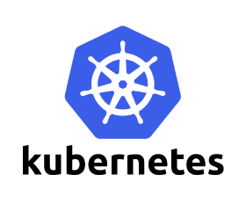
Azure Micro-services Platforms
Azure Container Service
Azure Service Fabric Cluster
IAAS
Service Fabric
Notes:
This slide shows several popular platforms on which developers are building and deploying microservices applications today. All of these can run on Azure infrastructure, giving you choice based upon your requirements.
Docker Swarm and Docker Compose
The standard packaging format and resource isolation of Docker containers have made them a natural fit with microservices architectures. Docker Compose defines an application model that supports multiple Docker-packaged microservices, and Docker Swarm serves as a cluster manager across a set of infrastructure that exposes the same protocol that a single-node Docker installation does, so that it works with the broad Docker tooling ecosystem. The Azure Container Service supports both Docker Swarm and Docker Compose. More details running this on Azure can be found here.
Mesosphere DCOS, with Apache Mesos and Marathon
Microsoft and Mesosphere have partnered to bring open source components of the Mesosphere Datacenter Operating System (DCOS), including Apache Mesos and Marathon, to Azure. The Mesosphere DCOS, powered by Mesos, is a scalable cluster manager that includes Mesosphere’s Marathon, a production-grade container orchestration tool. It is available as part of the Azure Container Service. There is also an enterprise version available from Mesosphere that runs on Azure. The Mesosphere DCOS provides microservices platform capabilities including service discovery, load-balancing, health-checks, placement constraints, and metrics aggregation. Finally, Mesosphere offers a library of certified services that provide additional capabilities, like Kafka, Chronos, Cassandra, Spark and others, which can all be installed with a single command. More details running this on Azure can be found here.
Service Fabric
To support our own internal evolution from on-premises to cloud and from monolithic to microservice-based applications, we developed Service Fabric over ten years ago. Service Fabric powers many of our hyper-scale cloud services, including SQL DB, DocDB, Intune, Cortana and Skype for Business, as well as many internal Azure infrastructure services. We’ve taken the exact same technology and released Service Fabric as-a-service on Azure, and the standalone SDK will enable the deployment of Service Fabric applications in on-premises clusters and on other clouds. In its initial public release, Service Fabric runs on Windows with any .NET language and Linux and Java support are under development. Service Fabric has built-in support for lifecycle management, hybrid deployments, and 24x7 availability with integrated development experiences using Visual Studio. The platform offers extensible health models for both the infrastructure and microservices to enable automated health-based upgrade and automatic rollback, simplifying DevOps. Furthermore, Service Fabric supports both stateless and stateful microservices with leadership election to support data consistency and a state replication framework that supports transactions for stateful data guarantees.
Kubernetes
Kubernetes is an open-source system for automating deployment, operations, and scaling of containerized applications. It groups containers that make up an application into logical units for easy management and discovery. Originally developed by Google, it builds on their experiences running large scale services such as Search and Gmail. Even some traditional PaaS solutions are merging with Kubernetes, like Apprenda. More details running Kubernetes on Azure can be found here.
OpenShift
OpenShift by Red Hat is a platform-as-a-service offering that leverages Docker container-based packaging for deploying container orchestration and compute management capabilities for Kubernetes, enabling users to run containerized JBoss Middleware, multiple programming languages, databases and other application runtimes. OpenShift Enterprise 3 offers a devops experience that enables developers to automate the application build and deployment process within a secure, enterprise-grade application infrastructure. With recent support for Red Hat Enterprise Linux images in Azure, OpenShift is supported in Azure. Look for some documentation on this topic shortly.
Pivotal Cloud Foundry
Pivotal Cloud Foundry enables microservice architectures by combining workflow and container scheduling from Cloud Foundry with integrations for microservice patterns like service discovery, client side load balancing, circuit breakers and distributed tracing, utilizing Spring Cloud and NetflixOSS. Pivotal Cloud Foundry supports ongoing microservice operations via deployment and service management capabilities such as autoscaling, blue-green updates, health monitoring, application metrics, streaming logs and more. Learn more about running Pivotal Cloud Foundry on Azure here.

Slide 26
Docker Containers

Slide 27
Containers
App A
App A
App B
Bins/Libs
Bins/Libs
Bins/Libs
VM
What are they?
Unit of deployment
Isolated environment
Isolated collection of resources
What are the benefits?
Instant startup
Repeatable and reliable execution
Scenarios
Dev/Test
Fast-scaling
Continuous deployment
Guest OS
Guest OS
Guest OS
Hypervisor
Host OS
Physical Server
App
A
App
A
App
B
App
B
App
B
Container
Bins/Libs
Bins/Libs
Container Manager
Host OS
Physical Server
Notes:
Container When you see “containers” you probably think of Docker. For good reason, Docker has essentially defined the container market. To understand what Docker is let’s start by looking at Containers.
Containers are an isolated environment and isolated collection of resources that an application runs in. The resources are all the dependencies (DLL’s, configuration, etc.) that the application needs. Everything the application needs to run is in the container and it sees nothing on the host OS it is running on (except maybe an internet connection). Containers are therefore a unit of deployment.
A key benefit of containers is that they can startup almost instantly. The notion of “booting up” a guest OS doesn’t exist. The container just runs on top of the host OS. As a result, containers can startup almost instantly as compared to the startup period of a VM. And because everything is contained in this container, containers are easily repeatable and extremely reliable from one environment to the next. For example, I can run a container on my local dev box and have high confidence it will run the same when deployed to another machine, such as a VM running in Azure.
As you can probably imagine, containers are extremely popular in dev/test scenarios. They are also great for micro-services.
To put a visual behind this, consider the architecture for a typical virtual machine. You have a physical server, hyper-visor and host OS. Then, each VM has it’s own guest OS that can be configured with applications and application frameworks. This is what you saw earlier in the presentation.
Now consider how a container is different. Physical Server with a host OS. However, notice there is not a guest OS. The container is essentially the application and it’s dependencies. Also notice that the app frameworks used by application A and application B are shared in this model. This is how instant startup is achieved.
Note that there are more instances of the same App running on the physical server. This underlines that a container is a scale unit besides being an isolation mechanism. In a production development you would use a cluster of hosts, and have containers spread of the hosts.

Slide 28
Anatomy of a Container Image
Application
Layer N (e.g. company config)
Wordpress
PHP
Layer 1 (e.g. Apache)
Platform Image
(Runtime Environment)
Notes:
Containers are run using images. An image is a base that is used to start a container, and you can spin up any number of containers based on an image. An image usually consists of multiple layers.
<click>
You start with a Platform Image, which is the runtime environment you want to build on. When running on Linux, there are platform images for distributions such as Ubuntu and CentOS, and platform images with additional tools such as MariaDB.
<click>
On top of that you can have additional layers, for instance an installation of Apache for a web server, with additional layers all the way up to configuration that is specific to a specific group of applications.
<click>
In between you could have additional frameworks, libraries, and bins, such as PHP or Wordpress.
<click>
The top layer is the application itself.
Layers are combined into a single image when you build the image.

Slide 29


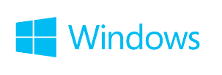
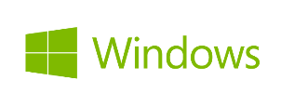
Container Ecosystem via Docker
Container Run-Time
Container Images
Image Repository
Linux
Docker API / Client
Docker images
Docker Hub
(trusted repositories)
Notes:
Docker has also pretty-much defined the container ecosystem (de-facto standard). It provides the means for deploying these containers and resources onto a machine by developing a Docker API that drives these activities.
The container runtime traditionally only ran on Linux VM’s. However, today, Windows Server 2016 provides a new “Container Role” (similar to other roles like AD, File Server, etc.) that you can configure on Windows. This provides the same abilities to create and manage containers that exists on Linux.
<Click>
Docker has also become the standard for defining what a container image looks like. The file format, the manifest that goes into the container, and how image dependencies are configured. And Windows and .NET are perfectly valid candidates for a Docker image.
<Click>
Docker has become the standard place for people to publish their images. Docker Hub is a public “trusted repository” where you can find literally thousands of Docker images such as Apache, MySQL, and even .NET.
Microsoft Azure embraces this container technology and has integrated it directly into the platform.

Slide 30
Docker, Docker Trusted Registry, Container Apps

Slide 31
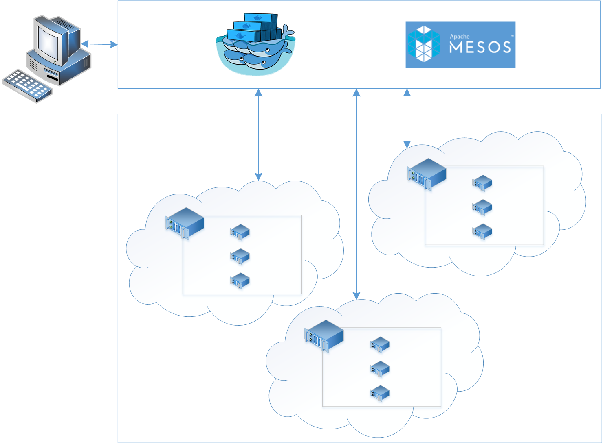
Azure Container Services
App1
App2
Notes:
The Azure Container Service provides the capability to run docker containers on top of a docker cluster. A cluster is a collection of docker hosts (i.e. servers). An orchestration platform manages the comtainers run on the different hosts. It puts containers on different hosts depending on the needs, and scales the number of containers if demand increases.
<click>
The containers comprising App1 and App2 can be placed on the hosts like this for instance. When containers or hosts fail, the orchestration platform recreates containers as needed, potentially on different hosts.
In ACS a cluster is managed with Docker Swarm or Apache Mesos. Swarm is newer and more modern, but Mesos is a more proven platform. Because container technology is evolving so rapidly, there is no telling what it will look like in a few years. ACS therefore builds on an open architecture, that enables us to add additional orchestration platforms in the future.

Slide 32
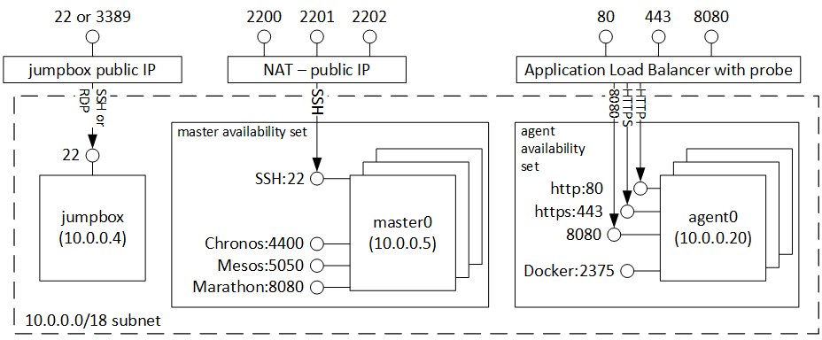
Azure Container Service Architecture
agent
VM Scale Set
Notes:
TODO: Improve graphic.
The Architecture for the Azure Container Service looks like this. On the right you see a VM Scale Set with docker hosts. This can scale automatically as demand increases. The load balancer makes sure load is distributed to the right containers (i.e. hosts), and uses probes to determine the health of a container.
On the left you see the master, which orchestrates the containers. This can be either Docker Swarm or Apache Mesos. To ensure high availability, the master consists of multiple VMs in an availability set. The load balancer uses NAT rules so you can reach the different VMs.
When you create an ACS environment, this is what you get. Once deployed, you are responsible to manage it. As such, it is not a full PaaS service. However, setting up a full blown docker environment in Azure yourself takes quite some effort, and requires you to optimize a lot of configuration. A typical Mesos configuration consists of about 5000 lines of configuration code. ACS uses an optimized configuration, and then provides you with the power to make changes specific to your needs.

Slide 33
Azure Container Services
Service Tooling
Container Tooling
Layer | Supported Technologies
Configuration as Code | ARM, Dockerfile, Docker Compose, Marathon.json
Host cluster management | VM Scale Sets
Container orchestration | Docker Swarm, Chronos, Marathon, Apache Mesos
Monitoring | OMS, App Insights
ARM Template
Containers
Container Services (1st party, 3rd party)
Windows Server
Linux
VMs and VM Scale Sets
Azure Stack
Azure
Notes:
Key points:
Pluggable. We run Swarm and Mesos. Others could run other platforms.
We tie into the existsing open source tooling and standards, so you can use tools that are already available.
Monitoring is also pluggable. Initially only OMS and App Insights.

Slide 34
Azure Container Service

Slide 35
Service Fabric

Slide 36
Services built with Service Fabric
Skype for Business
Hybrid Ops
Azure Document DB
Billions of transactions/week
Intune
800k+ devices
Azure Core Infrastructure
Event Hubs
20bn events/day
Bing Cortana
500m evals/sec
Azure SQL Database
1.4 million databases
Power BI
More!
IoT
Notes:
Service Fabric is a programming platform on which you can build highly scalable, resilient, distributed applications. Service Fabric is a proven platform on which Microsoft has built many existing services, from the Azure Core Infrastructure, Azure DocumentDB, and Event Hubs, driving many custom applications, to Bing, Skype for Business, and Bing that drive some of our most used services. Service Fabric is now available to you, and you can build your own apps using Visual Studio and the .NET Framework.
Linux and Java are currently in preview.

Slide 37
Microsoft Azure Service Fabric A platform for reliable, hyperscale, microservice-based applications
Microservices
High Availability
Data Partitioning
Service Fabric
Health Monitoring
Code Orchestration & Lifecycle Management
Hybrid Operations
Self-healing
Simple programming models
High Density
Rolling Upgrades
Low Latency
Placement Constraints
Replication & Failover
Stateful Services
Fast Startup & Shutdown
Resource Management
Hyper-Scale
Automated Rollback
Azure
Private cloud
Other clouds
Notes:
If you develop an application with Service Fabric, you get a simple development model with many features built-in, without having to write a single line of code. By default, your code is highly available and resilient to failure. The underlying platform takes care of keeping your application running, even if the underlying hardware fails. Service Fabric also ties into DevOps, with extensive health monitoring, and features like rolling updates with automated rollback in case a problem is detected with the new version being deployed.
Of course Service Fabric runs well on Azure, but we will also enable you to run Service Fabric applications on-prem or in other cloud platforms. The on-prem runnable version is currently in preview.

Slide 38
Cluster
Set of OS instances (real or virtual) stitched together to form a pool of resources
Cluster can scale to 1000s of machines, is self repairing, and scales-up or down
Acts as environment-independent abstraction layer
Windows OS
Windows OS
Windows OS
Fabric
Node
Fabric
Node
Fabric
Node
Windows OS
Windows OS
Windows OS
Fabric
Node
Fabric
Node
Fabric
Node

Slide 39
Service type
Services types are composed of code/config/data packages
Code packages define an entry point (dll or exe)
Config packages define service specific config information
Data packages define static resources (eg. images)
Packages can be independently versioned
<ServiceManifest Name="QueueService" Version="1.0">
<ServiceTypes>
<StatefulServiceType ServiceTypeName="QueueServiceType" HasPersistedState="true" />
</ServiceTypes>
<CodePackage Name="Code" Version="1.0">
<EntryPoint>
<ExeHost>
<Program>ServiceHost.exe</Program>
</ExeHost>
</EntryPoint>
</CodePackage>
<ConfigPackage Name="Config" Version="1.0" />
<DataPackage Name="Data" Version="1.0" />
</ServiceManifest>
Service Type 1
Code
Config
Data

Slide 40
Application type
Declarative template for creating an application
Based on a set of service types
Used for packaging, deployment, and versioning
Application Type A
Service Type 1
Service Type 2
Service Type 3
Code
Config
Data
Code
Config
Data
Code
Config
Data

Slide 41
Service Fabric Programming Models
Guest Executables
Bring any exe
Any language
Any programming model
Packaged as Application
Gets versioning, upgrade, monitoring, health, etc.
Reliable Services
Stateless & stateful services
Concurrent, granular state changes
Use of the Reliable Collections
Transactions across collections
Full platform integration
Reliable Actors
Stateless & stateful actor objects
Simplified programming model
Single Threaded model
Great for scaled out compute and state

Slide 42
Programming models: Reliable Actors
Independent units of compute and state
Large number of them executing in parallel
Communicates using asynchronous messaging
Single threaded execution
Automatically created and dehydrated as necessary

Slide 43
Service partitioning
Services can be partitioned for scale-out.
You can choose your own partitioning scheme.
Service partitions are striped across machines in the cluster.
Replicas automatically scale out & in on cluster changes
Node 1
Node 2
Node 3
Node 4
Node 5
Node 6
S
P2
P1
S
S
S
S
P3
P4
S
S
S

Slide 44
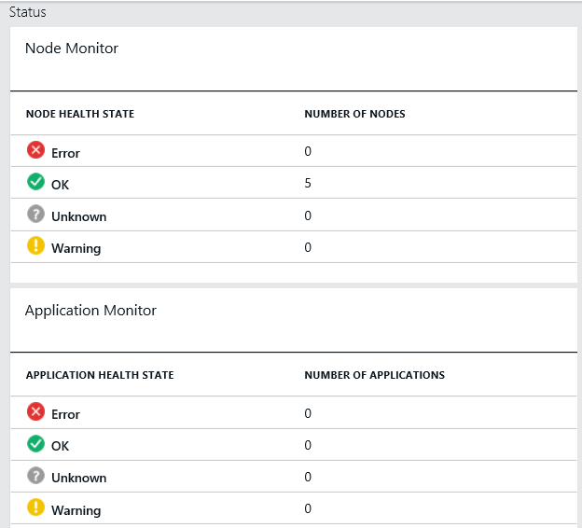
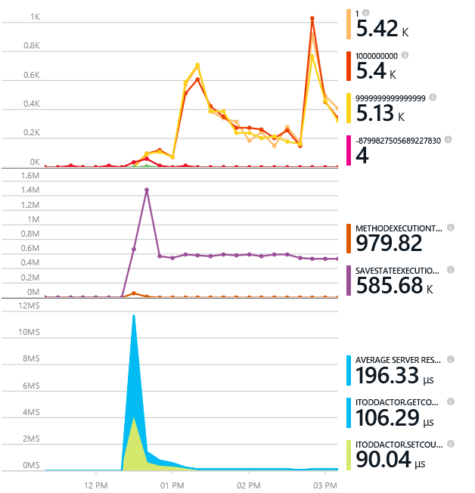
Monitoring your Services
Visibility into how your services are doing when running in production
Health status monitoring
Built-in health status for cluster and services
Flexible and extensible health store for custom app health reporting
Allows continuous monitoring for real-time alerting on problems in production
Performance and stress response
Rich built-in metrics for Actors and Services programming models
Easy to add custom application performance metrics

Slide 45
Diagnostics and Troubleshooting
Detailed System Optics
Repair suggestions. Examples: Slow RunAsync cancellations, RunAsync failures
All important events logged. Examples: App creation, deploy and upgrade records. All Actor method calls.
Custom Application Tracing
ETW == Fast Industry Standard Logging Technology
Works across environments. Same tracing code runs on devbox and also on production clusters on Azure.
Easy to add and system appends all the needed metadata such as node, app, service, and partition.
Choice of Tools
Visual Studio Diagnostics Events Viewer
Windows Event Viewer
Windows Azure Diagnostics + Operational Insights
Easy to plug in your preferred tools: Kibana, Elasticsearch and more

Slide 46
Application Upgrade
Upgrade Domain #1
Upgrade Domain #2
Upgrade Domain #3
App Repository
Windows OS
Windows OS
App A v1
Windows OS
App C v2
App A v1
App C v1
Fabric
Node
App B v2
Fabric
Node
Fabric
Node
App B v2
App C v2
App C v1
App C v1
App C v2
Windows OS
Windows OS
Windows OS
Fabric
Node
App B v2
App C v2
App B v2
App C v1
Fabric
Node
App A v1
App A v1
Fabric
Node

Slide 47
Service Fabric
Notes:
https://azure.microsoft.com/nl-nl/documentation/articles/service-fabric-create-your-first-application-in-visual-studio/

Slide 48
Compute on Azure
Rapid Development
App Service
Stream Analytics
Media Services
+++
Vertical Compute PaaS
General Compute PaaS
Azure Container Service
Azure Batch
Service Fabric
Cloud Foundry
VM Scale Sets
VM Extensions
IaaS and IaaS+
Virtual Machines
Full Control
Azure Public Cloud
Azure Stack

